Slide 1
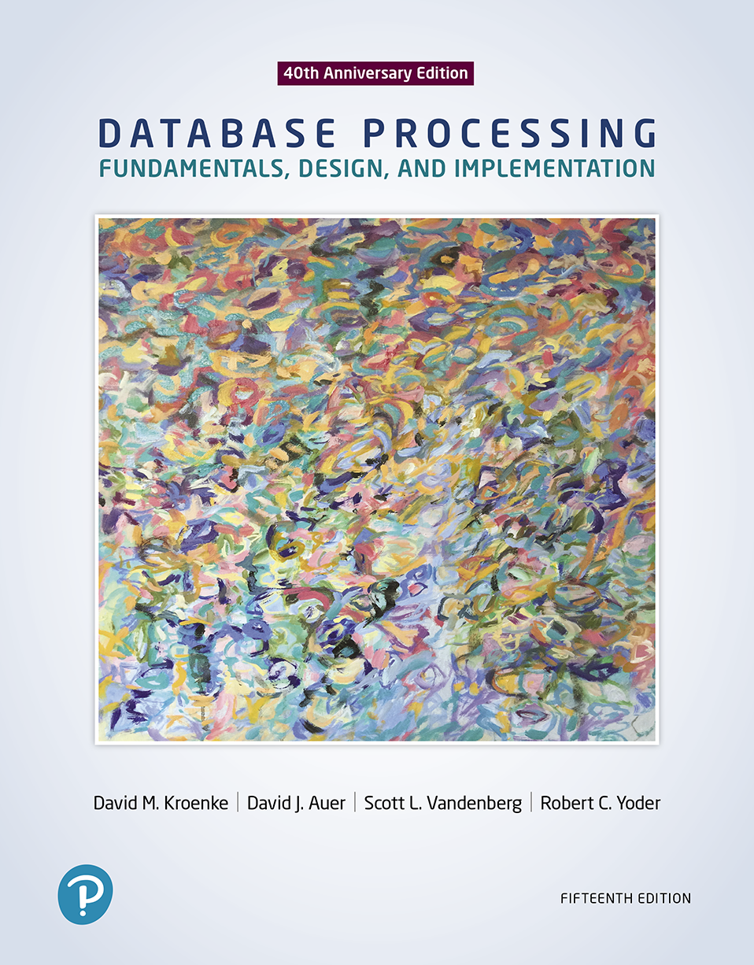
Database Processing: Fundamentals, Design, and Implementation
15th Edition
Week #1
Introduction

Slide 2
How Did We Get Here? The Internet World I
Personal Computers
1977: Apple II
1981: IBM PC
Local Area Networks
Ethernet networking technology
Early 1970s: Xerox Palo Alto Research Center
1983: U.S. National Standard

Slide 3
How Did We Get Here? The Internet World II
The Internet
1969: ARPANET
World Wide Web (WWW)
1993: First Web browser (Netscape) available
Mid 1990s: Online retail sites
1995: Amazon
Followed by Best Buy
Early 2000s: Web 2.0

Slide 4
How Did We Get Here? The Smartphone World
Mid 1970s: Mobile Phone (Cell Phone)
Smartphone
2007: Apple iPhone
2008: Google Android Operating System
Tablets
2010: Apple iPad
Apps
All of these examples depend on databases

Slide 5
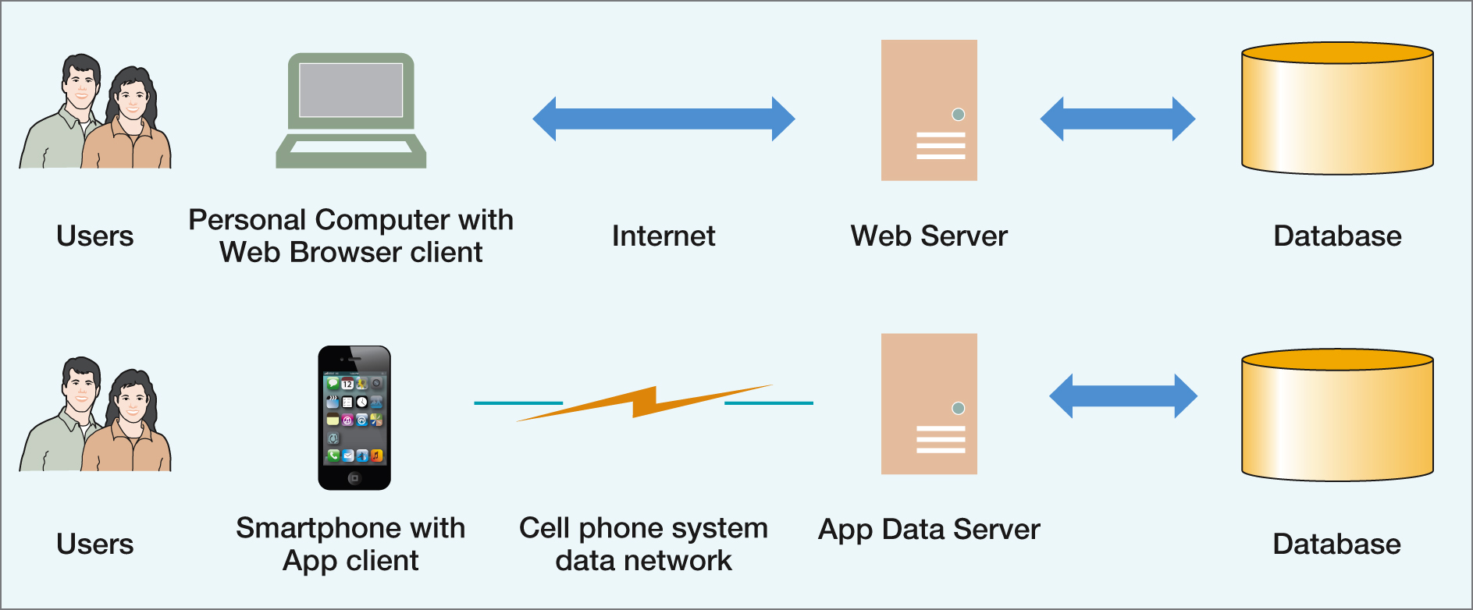
The Internet and Mobile Device World

Slide 6
Databases in the Internet and Mobile Device World
Databases are important because they are everywhere and are used daily:
Facebook
Twitter
Online shopping

Slide 7
The Characteristics of Databases
The purpose of a database is to help people track things of interest to them.
Data is stored in tables, which have rows and columns like a spreadsheet.
A database may have multiple tables, where each table stores data about a different thing.
Each row in a table stores data about an occurrence or instance of the thing of interest.
A database stores data and relationships.

Slide 8
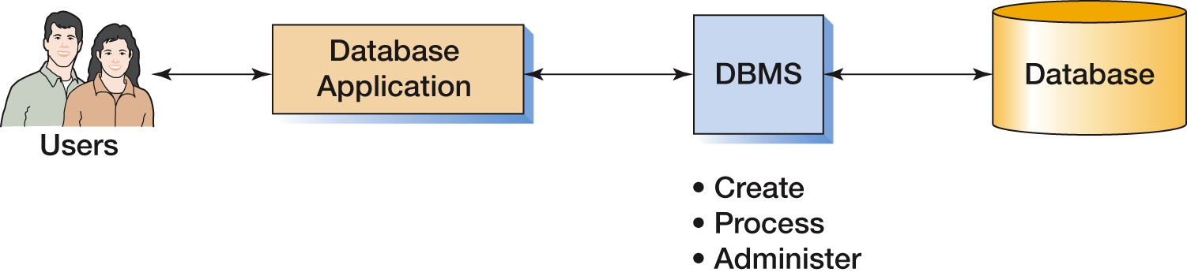
The Components of a Database System

Slide 9
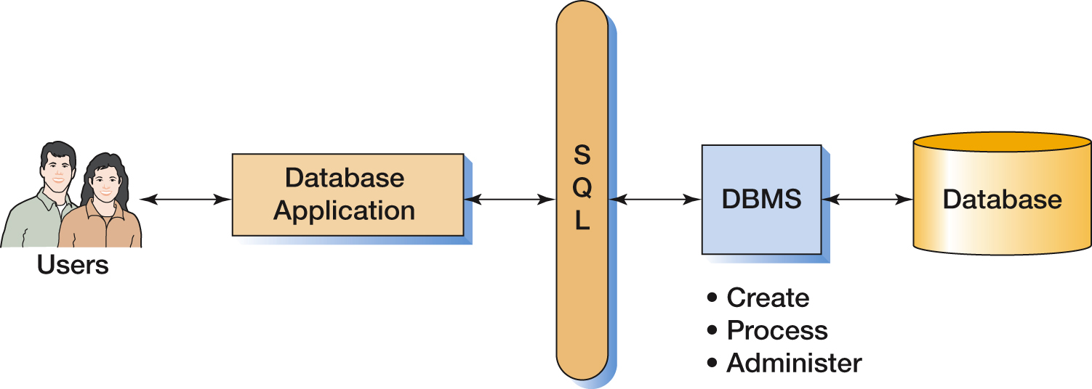
The Components of a Database System with SQL

Slide 10
Applications, the DBMS, and SQL
Applications are the computer programs that users work with.
The Database Management System (DBMS) creates, processes, and administers databases.
Structured Query Language (SQL) is an internationally recognized standard database language that is used by all commercial DBMSs.

Slide 11
Functions of a DBMS
Functions of a DBMS
Create database
Create tables
Create supporting structures (e.g., Indexes)
Modify (insert, update, or delete) database data
Read database data
Maintain database structures
Enforce rules
Control concurrency
Perform backup and recovery

Slide 12
The Database
A database is a self-describing collection of integrated tables.
The tables are called integrated because they store data about the relationships between rows of data.
A database is called self-describing because it stores a description of itself.
The self-describing data is called metadata, which is data about data.

Slide 13
Typical Metadata Tables (1 of 2)
TableName | NumberColumns | PrimaryKey
STUDENT | 4 | StudentNumber
CLASS | 4 | ClassNumber
GRADE | 3 | (StudentNumber, ClassNumber)

Slide 14
Typical Metadata Tables (2 of 2)
ColumnName | TableName | DataType | Length (bytes)
StudentNumber | STUDENT | Integer | 4
LastName | STUDENT | Text | 25
FirstName | STUDENT | Text | 25
EmailAddress | STUDENT | Text | 100
ClassNumber | CLASS | Integer | 4
Name | CLASS | Text | 25
Term | CLASS | Text | 12
Section | CLASS | Integer | 4
StudentNumber | GRADE | Integer | 4
ClassNumber | GRADE | Integer | 4
Grade | GRADE | Decimal | (2,1)

Slide 15
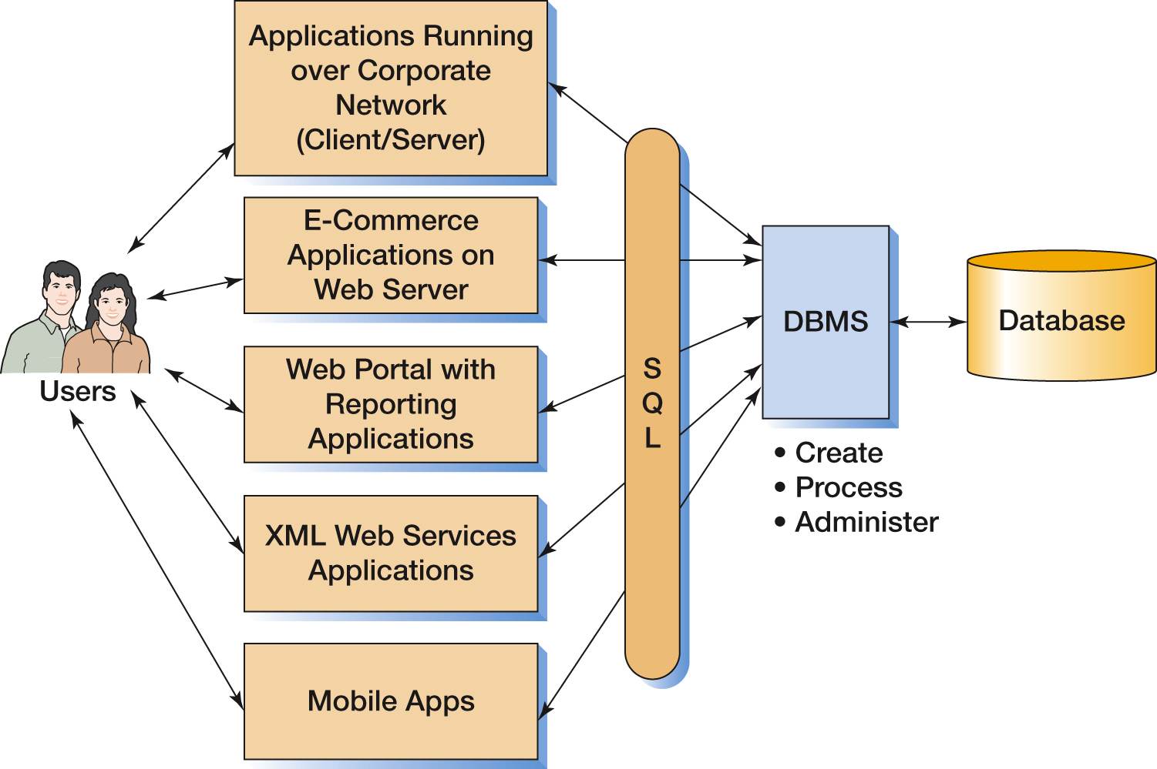
Components of an Enterprise-Class Database System

Slide 16
Three Types of Database Design
Types of Database Design Process
From existing data
Analyze spreadsheets and other data tables
Extract data from other databases
Design using normalization principles
New systems development
Crete data model from application requirements
Transform data model into database design
Database redesign
Migrate databases to newer databases
Integrate two or more databases
Reverse-engineer and design new database using normalization principles and data model transformation

Slide 17
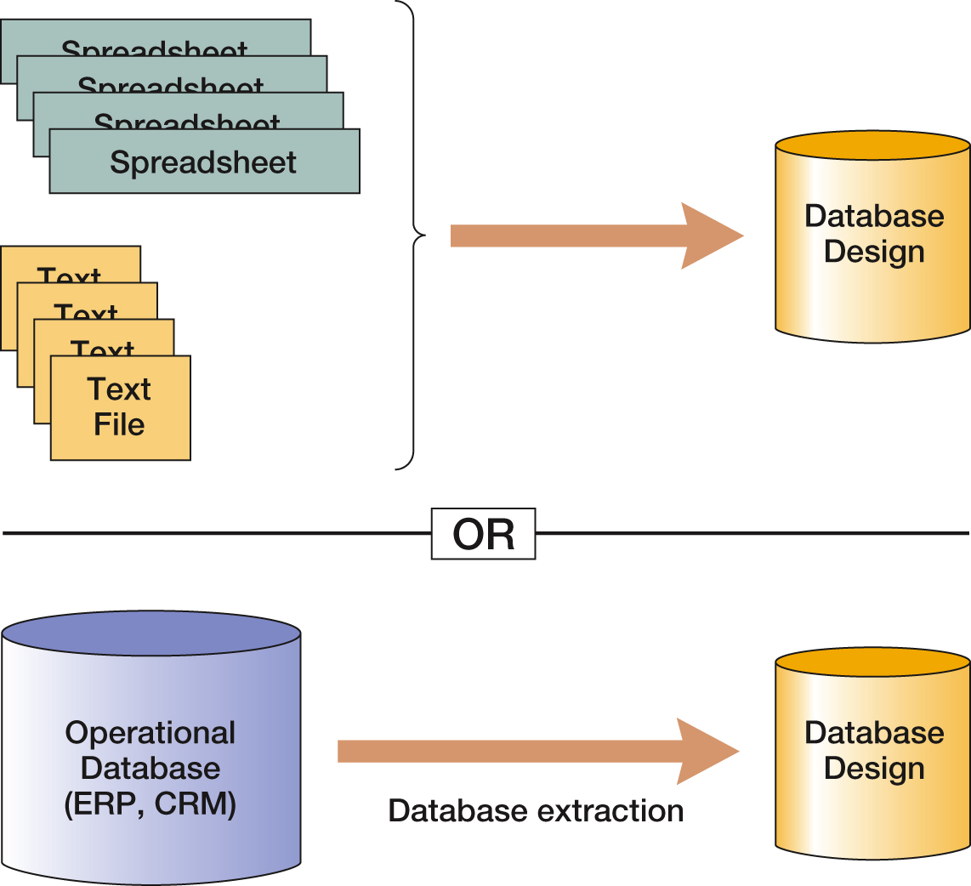
Databases Originating from Existing Data

Slide 18
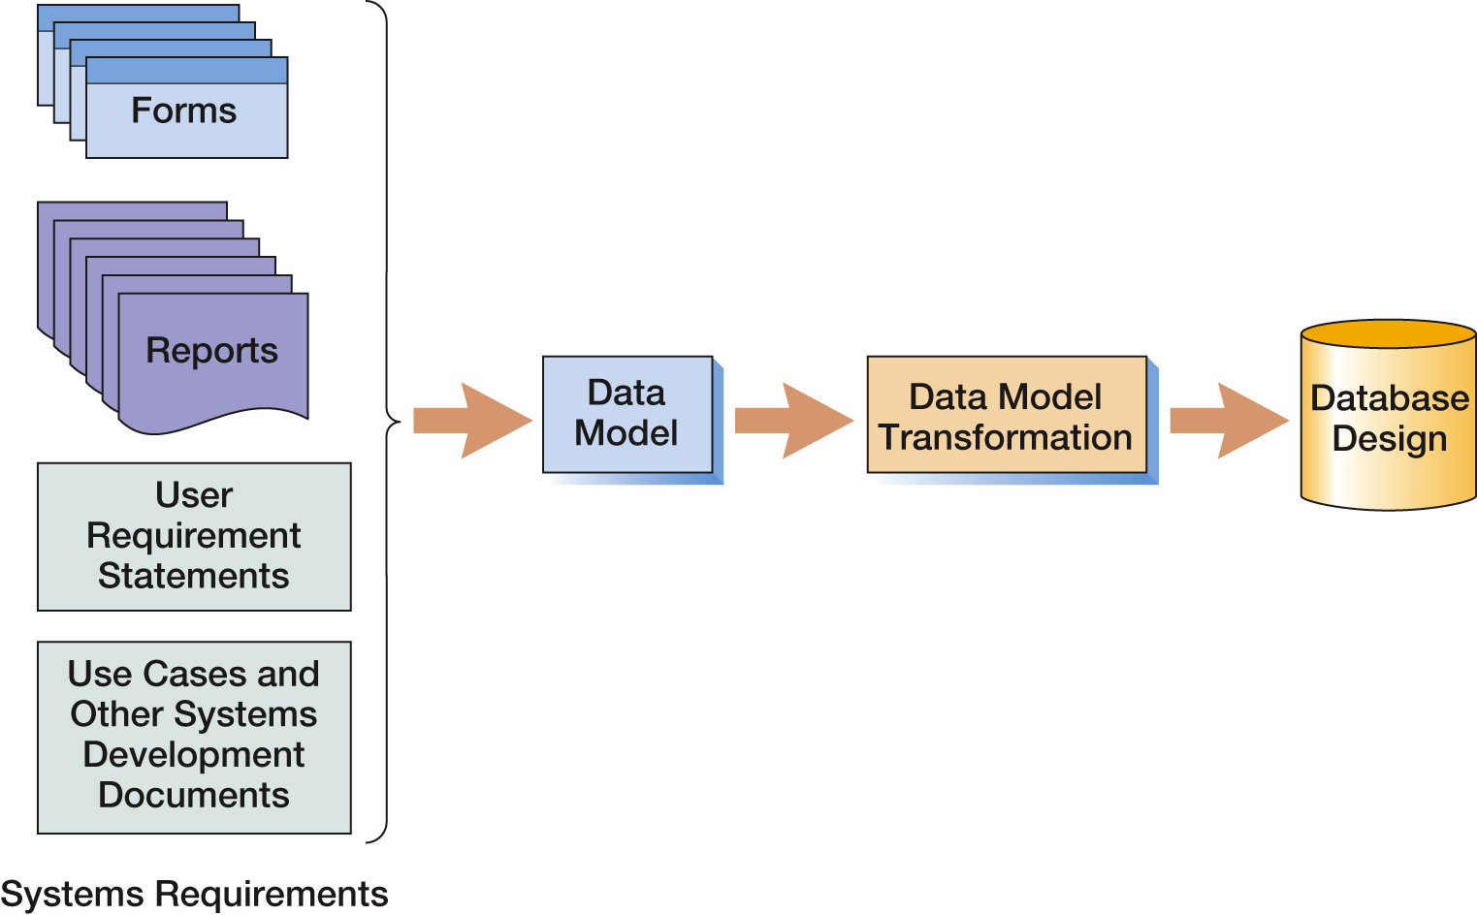
Database Originating from New Systems Development

Slide 19
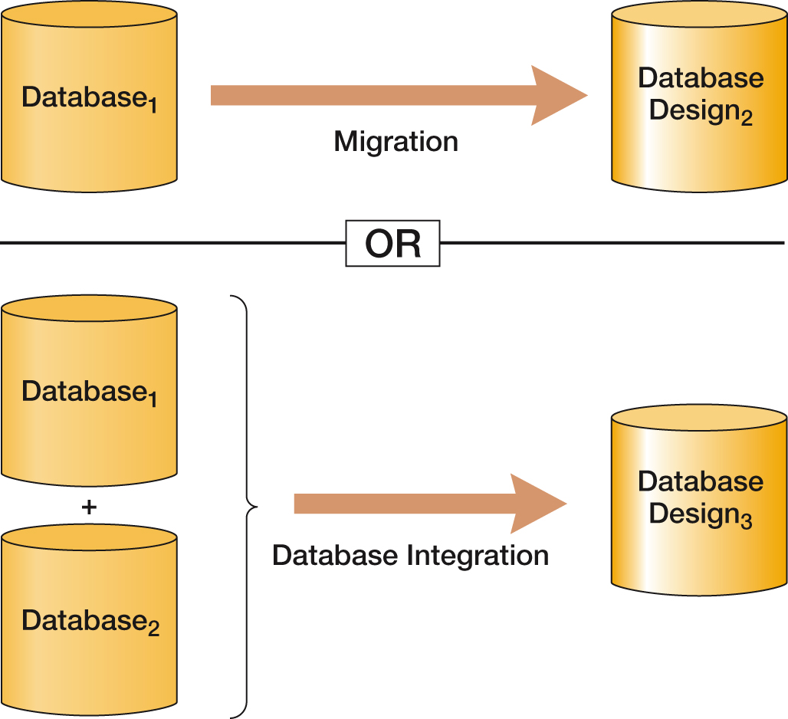
Databases Originating from Database Redesign

Slide 20
Database History (1 of 2)
Era | Years | Important Products | Remarks
Predatabase | Before 1970 | File Managers | All data were stored in separate files. Data integration was very difficult. File storage space was expensive and limited.
Early Database | 1970-1980 | ADABAS, System2000, Total, IDMS, IMS | First products to provide related tables. CODASYL DBTG and hierarchical data models (DL/I) were prevalent.
Emergence of relational model | 1978-1985 | DB2, Oracle Database, Ingres | Early relational DBMS products had substantial inertia to overcome. In time, the advantages weighed out.
Microcomputer DBMS products | 1982-1992+ | dBase-II, R:base, Paradox, Microsoft Access | Amazing! A database on a micro. All micro DBMS products were eliminated by Microsoft Access in the early 1990s.
Object-oriented DBMS | 1985-2000 | Oracle ODBMS, Gemstone, O2, Versant | Never caught on. Required relational database to be converted. Too much work for perceived benefit.

Slide 21
Database History (2 of 2)
Era | Years | Important Products | Remarks
Web Databases | 1995-Present | IIS, Apache, PHP, ASP.NET, and Java | Stateless characteristic of HTTP was a problem at first. Early applications were simple one-stage transactions. Later, more complex logic developed.
Open source DBMS products | 1995-Present | MySQL, PostgresQL, and other products | Open source DBMS products provide much of the functionality and features of commercial DBMS products at reduced cost.
XML, and Web services | 1998-Present | XML, SOAP, WSDL, UDDI, and other standards | XML provides tremendous benefits to Web-based database applications. Very important today. May replace relational databases during your career. See Chapter 11 and Appendix I.
Big Data and the NoSQL movement | 2009-present | Hadoop, Cassandra, Hbase, CouchDB, Arango DB, MongoDB, JSON and other products | Web applications such as Facebook and Twitter use Big Data technologies. The NoSQL movement is geared toward processing large data sets using NoSQL data models which replace relational databases with nonrelational data structures such as XML and JSON, and which may supplant relational databases during your career. See Chapter 12 and Appendices K and L.

Slide 22
The Relational Database Model
The dominant database model is the relational database model—all current major DBMS products are based on it.
It was created by IBM engineer E. F. Codd in 1970.
It was based on mathematics called relational algebra.

Slide 23
The NoSQL Movement and Big Data
Recent developments in Internet and mobile computing have resulted in the development of non-relational DBMSs.
NoSQL movement
Big Data
These do not replace the relational model, but rather complement it.

Slide 24
Database Processing Fundamentals, Design, and Implementation (15th Edition)
End of Presentation:
Week #1

